Slide 1

Natural Language Processing With Python
Chapter1-Language Processing and Python
Jianzhang Zhang
jianzhang.zhang@foxmail.com

Slide 2
课程考核说明
根据教学大纲要求，本课程的考核办法为：
总评 = 期末成绩 × 50 % + 平时成绩 × 50 %。
1.期末考核方法：闭卷考试
2.平时成绩由 3 项构成，具体如下：
（1） 日常作业 ，占比 30 %；
（2） 考勤 ，占比 10 %；
（3） 课堂表现 ，占比 10 %；

Slide 3
About the course
Elementary concepts and basics in computing linguistics
Interesting tasks of natural language processing and the solutions
Some useful tools and materials for text analysis and ming
Ability of Python programming for solving interesting language processing problems, such as readability, topic mining, and text quality etc.
Basic training of scientific paper reading and presentation

Slide 4

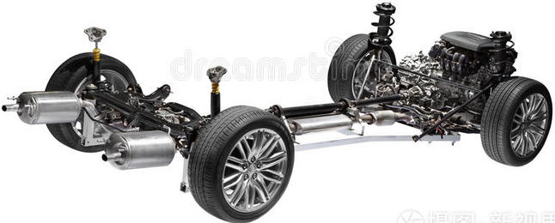
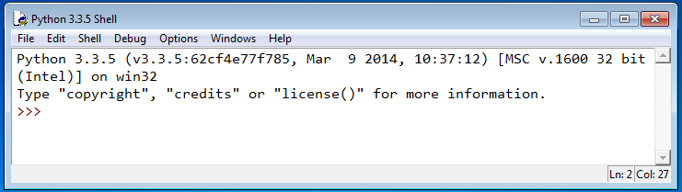
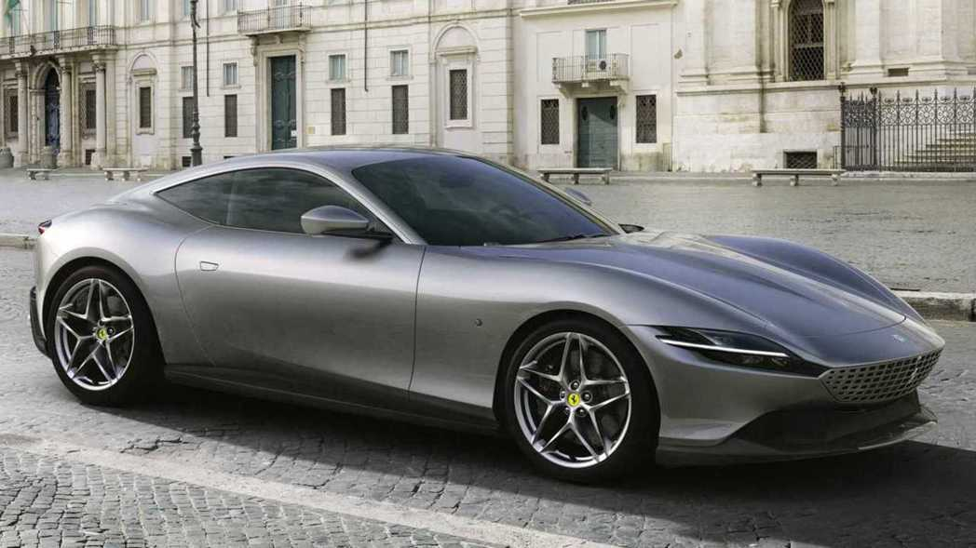



Basic tools and useful websites

Slide 5




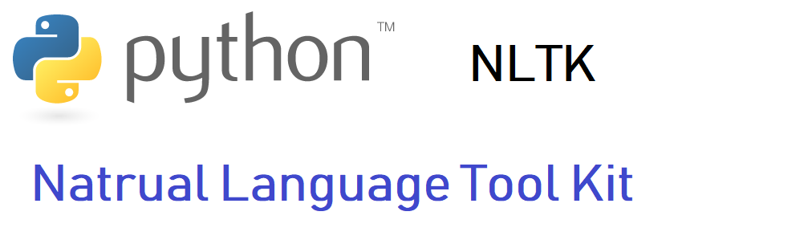

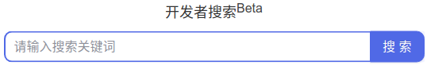
Basic tools and useful websites (Cont.)

Slide 6
Goals of This Chapter
What can we achieve by combining simple programming techniques with large quantities of text?
How can we automatically extract key words and phrases that sum up the style and content of a text?
What tools and techniques does the Python programming language provide for such work?
What are some of the interesting challenges of natural language processing?

Slide 7
1 Computing with Language: Texts and Words

Slide 8
1.1 Getting Started with Python
For more study materials, please refer to my course website for Programming Basics :
https://zhangjianzhang.github.io/programming_basics/

Slide 9
1.2 Getting Started with NLTK
Install the latest verson of NLTK
pip install nltk
Download NLTK data resource
https://www.nltk.org/nltk_data/ (manually) OR
import nltk
nltk.download()

Slide 10
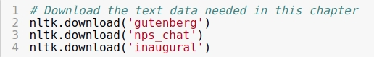
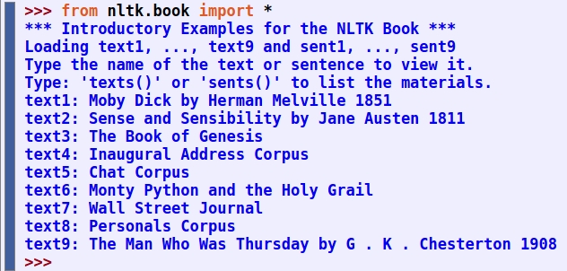
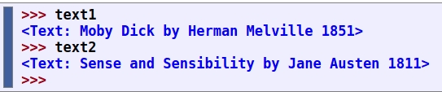
1.2 Getting Started with NLTK (contd.)

Slide 11
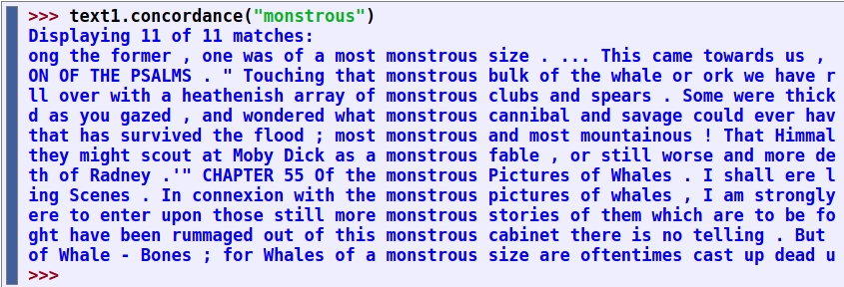
1.3 Searching Text
Examine the context of a text
Examibe how words have been used differently over time
Help you find proper words to be used when wring your own course paper or something else

Slide 12
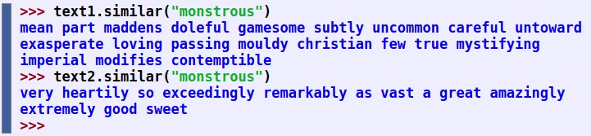
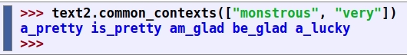
1.3 Searching Text (contd.)
Have a new sense of the richness and diversity of language
Find words in the similar context
Austen uses this word quite differently from Melville
Examine the contexts that are shared by two or more words

Slide 13
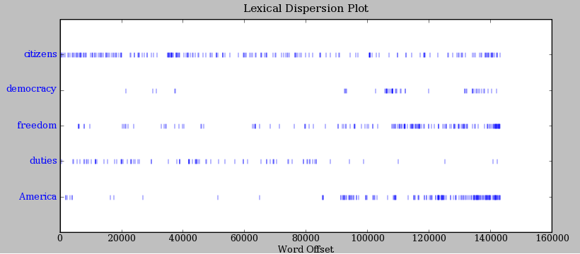
1.3 Searching Text (contd.)
Determine the location of a word in the text using a dispersion plot
Lexical Dispersion Plot for Words in U.S. Presidential Inaugural Addresses: This can be used to investigate changes in language use over time.

Slide 14
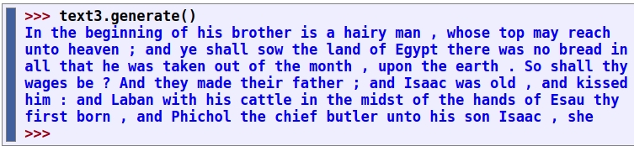
1.3 Searching Text (contd.)
Generate some random text in the various styles we have just seen just for fun

Slide 15
1.4 Counting Vocabulary
Count the words in a text in a variety of useful ways
Finding out the length of a text from start to finish
A token is the technical name for a sequence of characters — such as hairy, his, or :) — that we want to treat as a group
The vocabulary of a text is just the set of tokens that it uses
A word type is the form or spelling of the word independently of its specific occurrences in a text — that is, the word considered as a unique item of vocabulary
Calculate a measure of the lexical richness of the text
How often a word occurs in a text, and compute what percentage of the text is taken up by a specific word

Slide 16
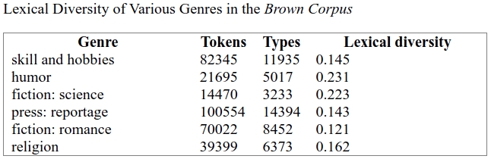
1.4 Counting Vocabulary (contd.)
Lexical Diversity of Various Genres in the Brown Corpus

Slide 17
2 A Closer Look at Python: Texts as Lists of Words

Slide 18
2 A Closer Look at Python: Texts as Lists of Words
Lists
Indexing Lists
Variables
Strings

Slide 19
3 Computing with Language: Simple Statistics

Slide 20
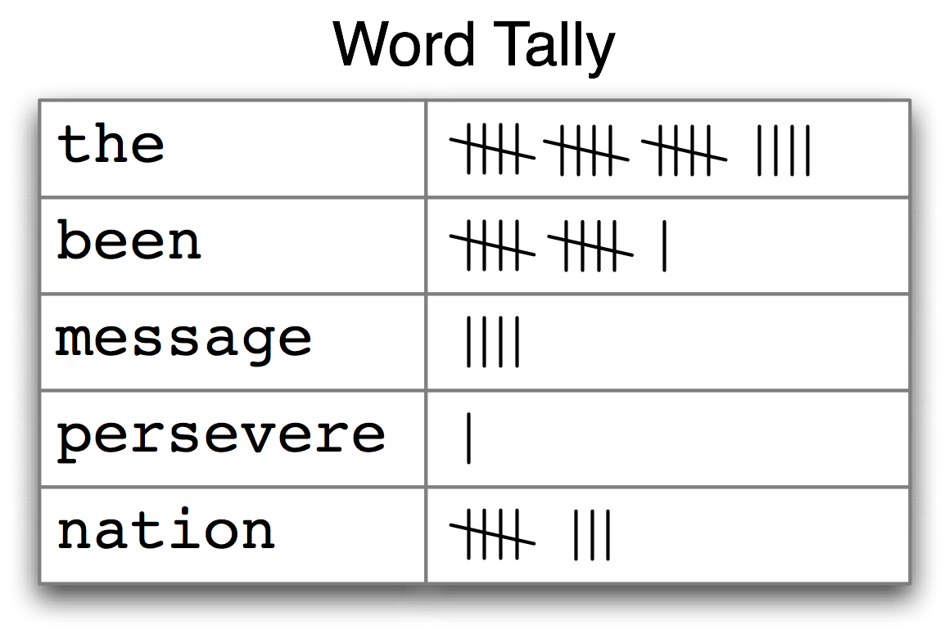
3.1 Frequency Distributions
Identify the words of a text that are most informative about the topic and genre of the text
Counting Words Appearing in a Text (a frequency distribution)

Slide 21
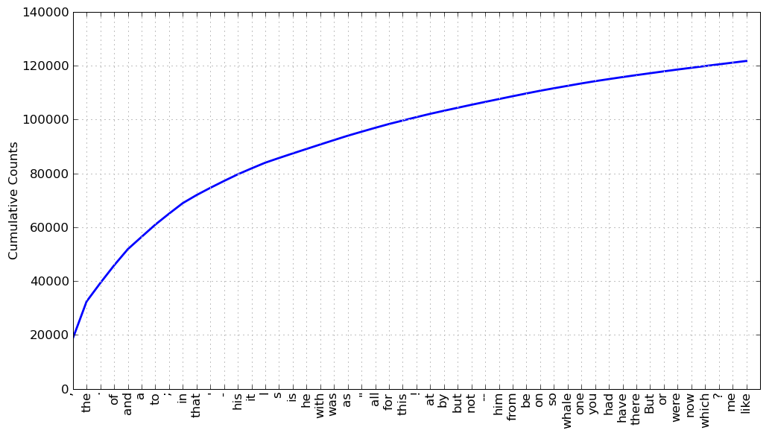
3.1 Frequency Distributions (contd.)
Cumulative Frequency Plot for 50 Most Frequently Words in Moby Dick: these account for nearly half of the tokens.
Only one word, whale, is slightly informative!

Slide 22
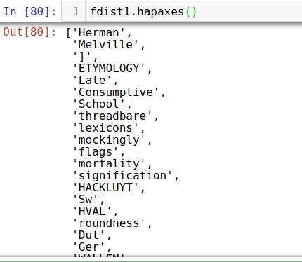
3.1 Frequency Distributions (contd.)
If the frequent words don't help us, how about the words that occur once only, the so-called hapaxes?
Since neither frequent nor infrequent words help, we need to try something else.

Slide 23
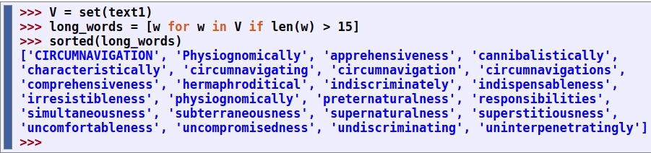
3.2 Fine-grained Selection of Words
let's look at the long words of a text; perhaps these will be more characteristic and informative
These very long words are often hapaxes (i.e., unique) and perhaps it would be better to find frequently occurring long words.

Slide 24
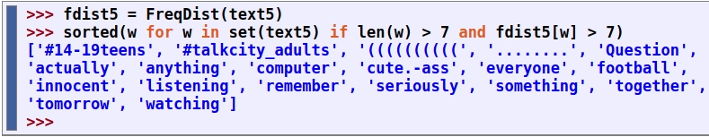
3.2 Fine-grained Selection of Words (contd.)
At last we have managed to automatically identify the frequently-occurring content-bearing words of the text.
It is a modest but important milestone: a tiny piece of code, processing tens of thousands of words, produces some informative output.

Slide 25
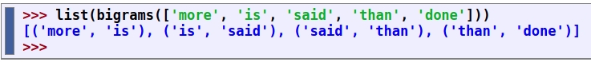
3.3 Collocations and Bigrams
A collocation is a sequence of words that occur together unusually often
Thus red wine is a collocation, whereas the wine is not. A characteristic of collocations is that they are resistant to substitution with words that have similar senses; for example, maroon wine sounds definitely odd.
To get a handle on collocations, we start off by extracting from a text a list of word pairs, also known as bigrams.

Slide 26
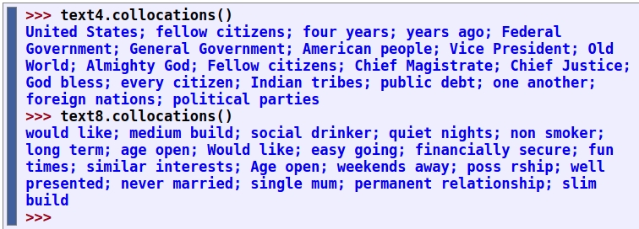
3.3 Collocations and Bigrams (contd.)
Collocations are essentially just frequent bigrams, except that we want to pay more attention to the cases that involve rare words
Find bigrams that occur more often than we would expect based on the frequency of the individual words.
The collocations that emerge are very specific to the genre of the texts. In order to find red wine as a collocation, we would need to process a much larger body of text.

Slide 27
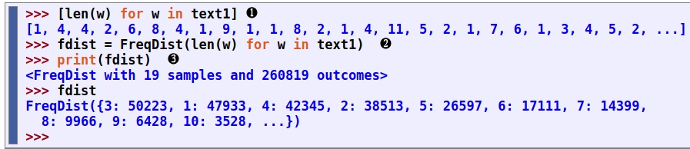
3.4 Counting Other Things
Counting words is useful, but we can count other things too. For example, we can look at the distribution of word lengths in a text

Slide 28
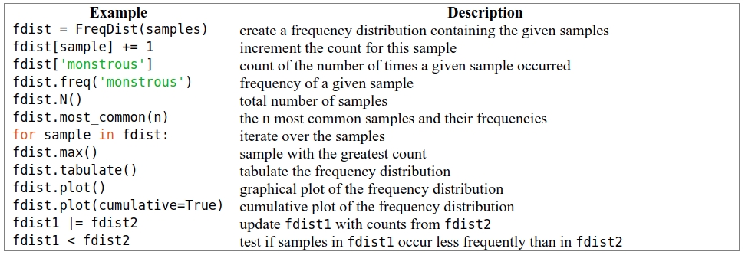
3.4 Counting Other Things (contd.)
Functions Defined for NLTK's Frequency Distributions

Slide 29
4 Back to Python: Making Decisions and Taking Control

Slide 30
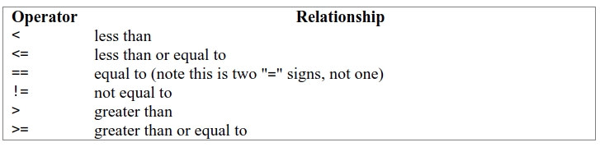
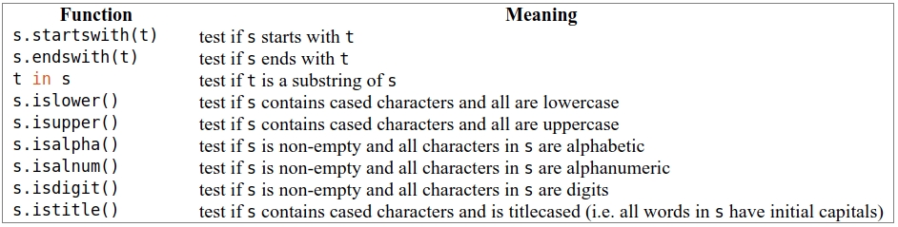
4.1 Conditionals
Numerical Comparison Operators
Some Word Comparison Operators

Slide 31
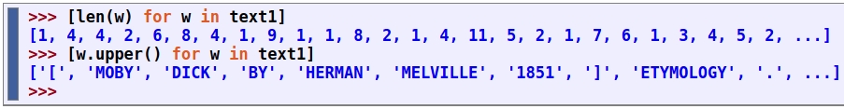
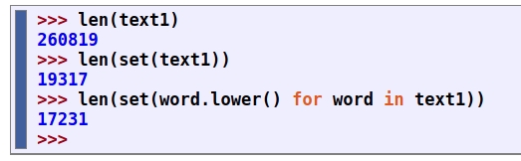
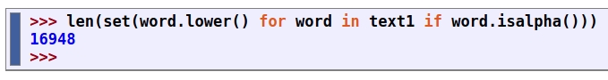
4.2 Operating on Every Element

Slide 32
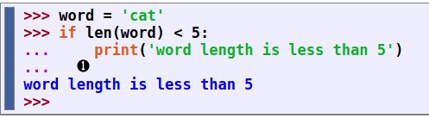
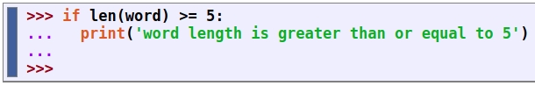
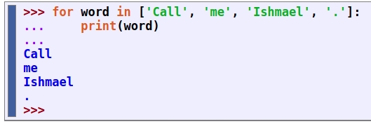
4.3 Nested Code Blocks

Slide 33
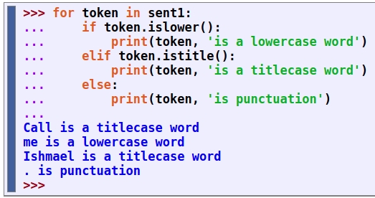
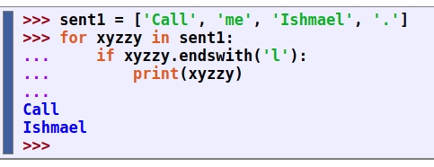
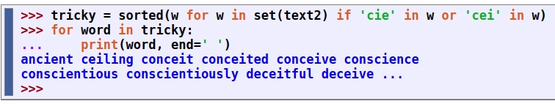
4.4 Looping with Conditions

Slide 34
5 Automatic Natural Language Understanding

Slide 35
5 Automatic Natural Language Understanding
Search engines have been crucial to the growth and popularity of the Web, but have some shortcomings. It takes skill, knowledge, and some luck, to extract answers to such questions as:
What tourist sites can I visit between Philadelphia and Pittsburgh on a limited budget?
What do experts say about digital SLR cameras?
What predictions about the steel market were made by credible commentators in the past week?
Getting a computer to answer them automatically involves a range of language processing tasks, including information extraction, inference, and summarization, and would need to be carried out on a scale and with a level of robustness that is still beyond our current capabilities.

Slide 36
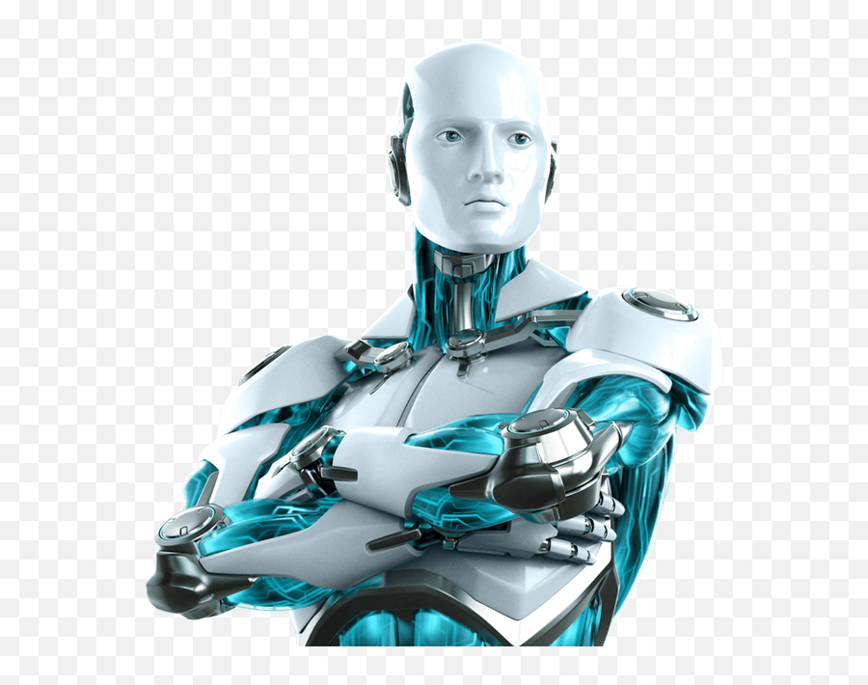
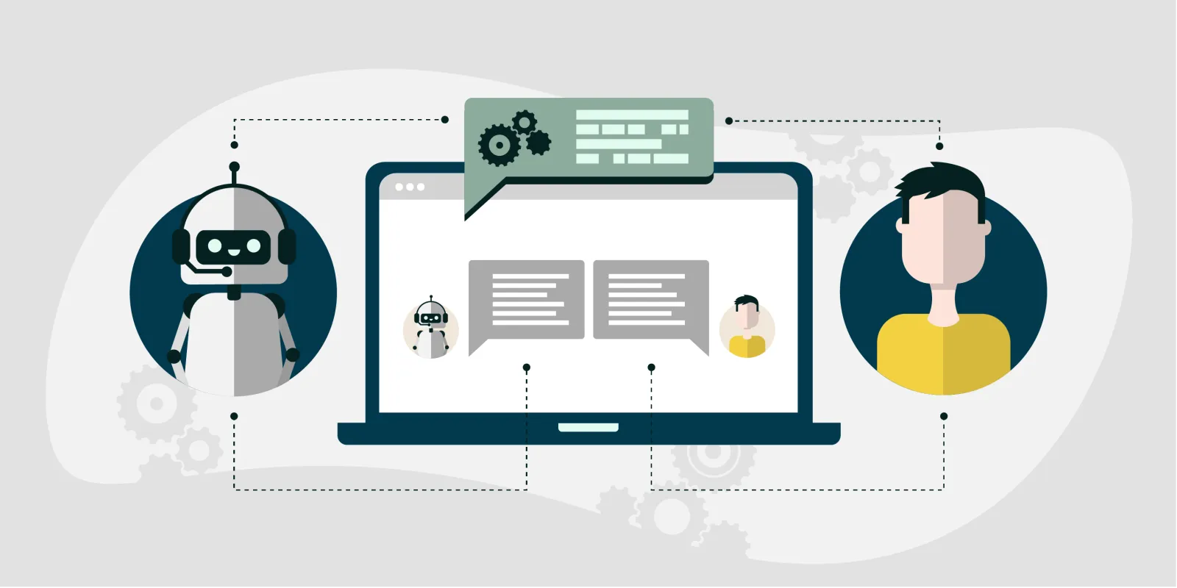
5 Automatic Natural Language Understanding
On a more philosophical level, a long-standing challenge within artificial intelligence has been to build intelligent machines, and a major part of intelligent behaviour is understanding language.
As NLP technologies become more mature, and robust methods for analyzing unrestricted text become more widespread, the prospect of natural language understanding has re-emerged as a plausible goal.

Slide 37
5.1 Word Sense Disambiguation
In word sense disambiguation we want to work out which sense of a word was intended in a given context. Consider the ambiguous words serve and dish :
a. serve: help with food or drink; hold an office; put ball into play
b. dish: plate; course of a meal; communications device
he served the dish
他端上了这道菜（很自然想到的场景和画面）
他在摔盘子（网球运动员在球场边瓷茶具，可能在发火，三个词同时包含运动和瓷器这两个不同的主题，一般不太可能）
We automatically disambiguate words using context, exploiting the simple fact that nearby words have closely related meanings.

Slide 38
5.1 Word Sense Disambiguation (contd.)
The meaning of the italicized word helps us interpret the meaning of by
a. The lost children were found by the searchers (agentive)
b. The lost children were found by the mountain (locative)
c. The lost children were found by the afternoon (temporal)
We automatically disambiguate words using context, exploiting the simple fact that nearby words have closely related meanings.

Slide 39
5.2 Pronoun Resolution
A deeper kind of language understanding is to work out "who did what to whom" — i.e., to detect the subjects and objects of verbs.
Try to determine what was sold, caught, and found (one case is ambiguous) :
a. The thieves stole the paintings. They were subsequently sold.
b. The thieves stole the paintings. They were subsequently caught.
c. The thieves stole the paintings. They were subsequently found.
Answering this question involves finding the antecedent of the pronoun they, either thieves or paintings. Computational techniques for tackling this problem include anaphora resolution — identifying what a pronoun or noun phrase refers to — and semantic role labeling — identifying how a noun phrase relates to the verb (as agent, patient, instrument, and so on).

Slide 40
5.3 Generating Language Output
Question answering: a machine should be able to answer a user's questions relating to collection of texts.
a. Text: ... The thieves stole the paintings. They were subsequently sold. ...
b. Human: Who or what was sold?
c. Machine: The paintings.
Working out the sense of a word, the subject of a verb, and the antecedent of a pronoun are steps in establishing the meaning of a sentence, things we would expect a language understanding system to be able to do.

Slide 41
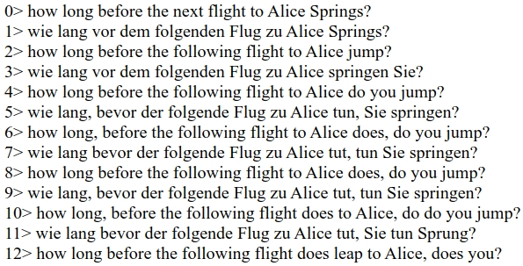
5.4 Machine translation
Machine translation (MT) has been the holy grail of language understanding, ultimately seeking to provide high-quality, idiomatic translation between any pair of languages.
Translating a sentence back and forth between a pair of languages until equilibrium is reached. (reveal shortcomings of MT)

Slide 42
5.4 Machine translation (contd.)
Today these difficulties are being faced by collecting massive quantities of parallel texts from news and government websites that publish documents in two or more languages. Given a document in German and English, and possibly a bilingual dictionary, we can automatically pair up the sentences, a process called text alignment. Once we have a million or more sentence pairs, we can detect corresponding words and phrases, and build a model that can be used for translating new text.

Slide 43
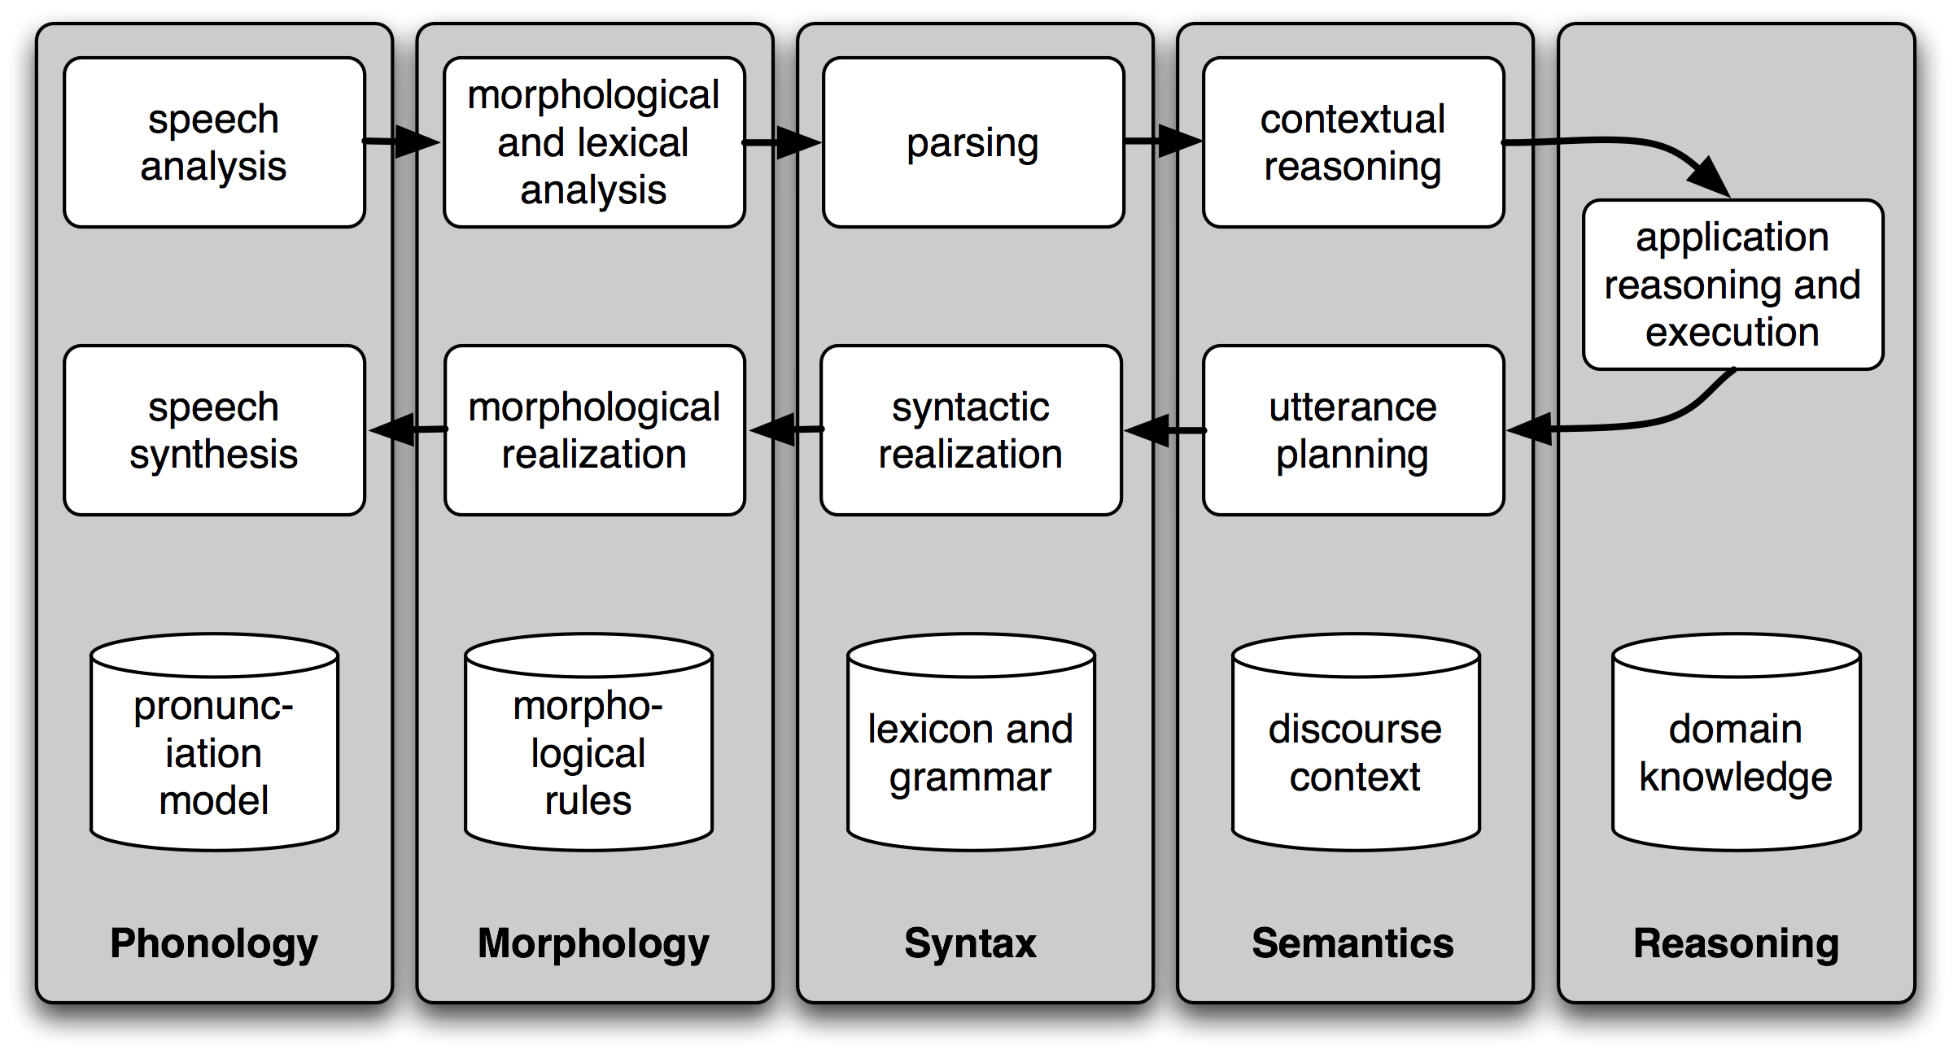
5.5 Spoken Dialog Systems
In the history of artificial intelligence, the chief measure of intelligence has been a linguistic one, namely the Turing Test: can a dialogue system, responding to a user's text input, perform so naturally that we cannot distinguish it from a human-generated response? In contrast, today's commercial dialogue systems are very limited, but still perform useful functions in narrowly-defined domains.

Slide 44
5.5 Spoken Dialog Systems (contd.)
Dialogue systems give us an opportunity to mention the commonly assumed pipeline for NLP.
The above figure shows the architecture of a simple dialogue system. Along the top of the diagram, moving from left to right, is a "pipeline" of some language understanding components. These map from speech input via syntactic parsing to some kind of meaning representation. Along the middle, moving from right to left, is the reverse pipeline of components for converting concepts to speech. These components make up the dynamic aspects of the system. At the bottom of the diagram are some representative bodies of static information: the repositories of language-related data that the processing components draw on to do their work.

Slide 45
5.6 Spoken Dialog Systems (contd.)
Recognizing Textual Entailment (RTE): find evidence from the Text to support or deny the Hypothesis.
a. Text: David Golinkin is the editor or author of eighteen books, and over 150 responsa, articles, sermons and books
b. Hypothesis: Golinkin has written eighteen books
In order to determine whether the hypothesis is supported by the text, the system needs the following background knowledge: (i) if someone is an author of a book, then he/she has written that book; (ii) if someone is an editor of a book, then he/she has not written (all of) that book; (iii) if someone is editor or author of eighteen books, then one cannot conclude that he/she is author of eighteen books.

Slide 46
5.7 Limitations of NLP
Despite the research-led advances in tasks like RTE, natural language systems that have been deployed for real-world applications still cannot perform common-sense reasoning or draw on world knowledge in a general and robust manner.
Right from the beginning, an important goal of NLP research has been to make progress on the difficult task of building technologies that "understand language," using superficial yet powerful techniques instead of unrestricted knowledge and reasoning capabilities.

Slide 47
6 Summary

Slide 48
Texts are represented in Python using lists: ['Monty', 'Python']. We can use indexing, slicing, and the len() function on lists.
A word "token" is a particular appearance of a given word in a text; a word "type" is the unique form of the word as a particular sequence of letters. We count word tokens using len(text) and word types using len(set(text)).
We obtain the vocabulary of a text t using sorted(set(t)).
We operate on each item of a text using [f(x) for x in text].
To derive the vocabulary, collapsing case distinctions and ignoring punctuation, we can write set(w.lower() for w in text if w.isalpha()).
We process each word in a text using a for statement, such as for w in t: or for word in text:. This must be followed by the colon character and an indented block of code, to be executed each time through the loop.

Slide 49
We test a condition using an if statement: if len(word) < 5:. This must be followed by the colon character and an indented block of code, to be executed only if the condition is true.
A frequency distribution is a collection of items along with their frequency counts (e.g., the words of a text and their frequency of appearance).
A function is a block of code that has been assigned a name and can be reused. Functions are defined using the def keyword, as in def mult(x, y); x and y are parameters of the function, and act as placeholders for actual data values.
A function is called by specifying its name followed by zero or more arguments inside parentheses, like this: texts(), mult(3, 4), len(text1).

Slide 50
7 Further Reading

Slide 51
ACL Anthology: https://aclanthology.org/
Speech and Language Processing (3rd ed. draft) by Dan Jurafsky and James H. Martin: https://web.stanford.edu/~jurafsky/slp3/

